Slide 1
The Cost of Living:
Income & Housing Prices
By Melanie, Lisa, & Priya

Slide 2

Goals
The Problem: Maximizing Your Income
The Solution:
Use earnings data, separated by job category & location
Acquire cost of housing data for major U.S. cities
Combine data sources & analyze to determine most profitable place to live, based on occupation
Use Cases:
Companies can maximize relocation and employee placement
Individuals can determine which area is most align with their standard of living

Slide 3
The Data
Median Home Values by City/US Metro Region
Different home types
Over Time
Household income by City/US Metro Region
Over Time (quarterly data is available)
Occupation income by City/US Metro Region
TYPE OF DATA
Zillow Housing Prices
Zillow Household Income
US Census:
Income by Occupation
SOURCE OF DATA

Slide 4
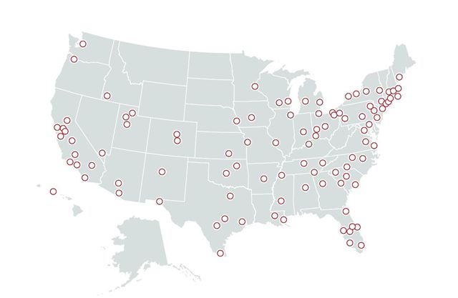
Information Challenges
Two different data sources
Data will need to be cleaned/merged/joined
No clear easy join keys
There exists a data lag of about 3-6 months
Need to align data to reflect concurrent point in time
Variety achieved
Must explore opportunities for increased Volume & Velocity

Slide 5
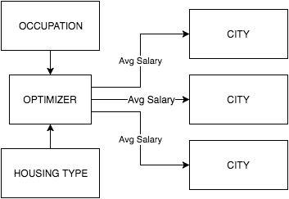
The Plan
Organize data into RDBMS
Structure to optimize analysis
Develop program that allows user find the top three cities they can afford to live given their occupation of choice

